Slide 1
Module 7
The OSI (Open System Interconnection) model.

Slide 2
Standard Protocols
The OSI model defines a conceptual framework for understanding network interactions.
Standards and protocols at each layer facilitate communication between devices.

Slide 3
Network protocols
This is a set of rules and procedures governing transmission between components in a computer network.
The functions of protocol in a network
To identify each device in the communication path
To secure the attention of the other devices
To verify correct receipt of the transmitted message.
To determine that a message requires retransmission if it is incomplete or has errors.
To perform recovery when errors occur

Slide 4
Standard protocols
Standard protocols are a set of rules or conventions that define how data is transmitted over a network. They ensure that devices can communicate with each other effectively.
Examples are:
Transmission Control Protocol (TCP). A connection-oriented protocol that provides reliable, ordered, and error-checked delivery of data.
Internet Protocol (IP). A network layer protocol that deals with the routing and addressing of data packets. For example IPV4 and IPV6.
Hypertext Transfer Protocol (HTTP). A protocol for transmitting hypertext over the internet. It is the foundation of data communication on the World Wide Web.
Telnet protocol – It provides terminal emulation that allows a personal computer or workstation to act as a virtual terminal, access device for a server.

Slide 5
Standard protocols
File Transfer Protocol (FTP). Used for transferring files between a client and a server on a computer network.
Simple Mail Transfer Protocol (SMTP). A protocol used for sending and receiving email.
Post Office Protocol (POP) and Internet Message Access Protocol. These Protocols used by email clients to retrieve emails from a mail server.
Domain Name System (DNS). Translates domain names into IP addresses, allowing users to access websites by name rather than numerical IP addresses.
Dynamic Host Configuration Protocol (DHCP). Automates the assignment of IP addresses and other network configuration information to devices on a network
Secure Shell (SSH). Provides secure command-line access to network devices

Slide 6
Reasons for using standard protocols
Standard protocols ensure that different devices and systems from various manufacturers can communicate with each other. This is Interoperability.
Standard protocols simplify the integration of new technologies and devices into existing networks.
Standard protocols support the scalability of networks. As the size and complexity of a network grow, the use of standard protocols makes it easier to add new devices and expand infrastructure without major compatibility issues.
Organizations can choose hardware and software solutions from different vendors without worrying about compatibility issues.
Standard protocols enable global communication by providing a common language for devices worldwide.
Standard protocols often come with built-in security features.
Standardized protocols simplify the troubleshooting process. Network administrators and technicians can rely on established guidelines and documentation when diagnosing and resolving issues
Standard protocols foster innovation by allowing developers to focus on creating new applications and services without worrying too much about the underlying communication mechanisms.
The use of standard protocols can contribute to cost savings. Organizations can avoid the expenses associated with developing and maintaining proprietary communication solutions, and they have a broader range of affordable hardware and software options to choose from

Slide 7
Reasons for layered approach in networking.
It facilitates changes or upgrades to one layer without affecting the others.
The separation of functions into distinct layers promotes interoperability.
The layered approach simplifies the design process. Designers can focus on one layer at a time, specifying its functions and interactions.
Troubleshooting and maintenance become more straightforward because issues can be isolated to a specific layer.
Each layer can have its own set of protocols and standards. This makes it easier to update or replace protocols at one layer without affecting the entire network.
Changes or upgrades in one layer do not necessarily impact the other layers.

Slide 8
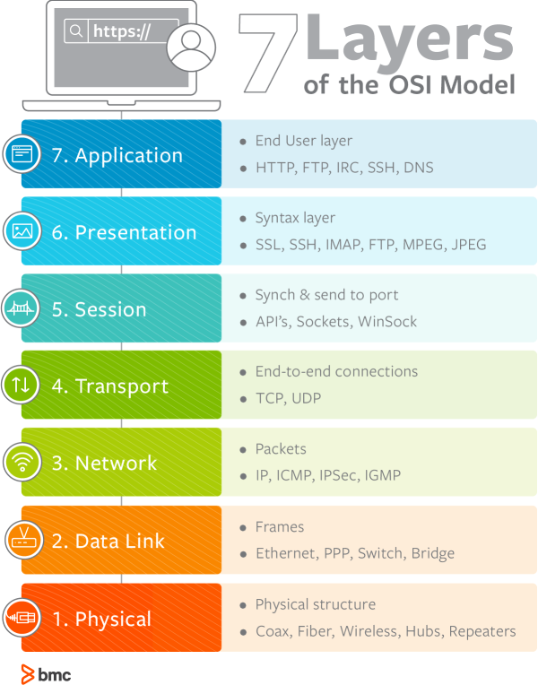
The OSI model
The OSI model consists of seven layers, each serving a specific function.

Slide 9
The Physical layer
Concerned with the physical connection between devices. The protocols in the physical layer are: Ethernet, USB, HDMI.
Notes:
1. Physical
The lowest layer of the OSI model is concerned with data communication in the form of electrical, optic, or electromagnetic signals physically transmitting information between networking devices and infrastructure. The physical layer is responsible for the communication of unstructured raw data streams over a physical medium. It defines a range of aspects, including:
Electrical, mechanical, and physical systems and networking devices that include specifications such as cable size, signal frequency, voltages, etc.
Topologies such as Bus, Star, Ring, and Mesh
Communication modes such as Simplex, Half Duplex, and Full Duplex
Data transmission performance, such as Bit Rate and Bit Synchronization
Modulation, switching, and interfacing with the physical transmission medium
Common protocols including Wi-Fi, Ethernet, and others
Hardware including networking devices, antennas, cables, modem, and intermediate devices such as repeaters and hubs

Slide 10
Data link layer
Responsible for node-to-node communication and error detection.
The protocols here are: MAC (Media Access Control) and PPP (Point To Point Protocol).
Notes:
Data Link
The second layer of the OSI model concerns data transmission between the nodes within a network and manages the connections between physically connected devices such as switches. The raw data received from the physical layer is synchronized and packaged into data frames that contain the necessary protocols to route information between appropriate nodes. The data link layer is further divided into two sublayers:
The Logical Link Control (LLC) sublayer is responsible for flow controls and error controls that ensure error-free and accurate data transmission between the network nodes.
The Media Access Control (MAC) sublayer is responsible for managing access and permissions to transmit data between the network nodes. The data is transmitted sequentially and the layer expects acknowledgement for the encapsulated raw data sent between the nodes.

Slide 11
Network Layer
Manages routing and addressing.
The protocols in this layer are: Internet Protocol (IP) and Internet Control Message Protocol (ICMP).
Notes:
3. Network
The third layer of the OSI model organizes and transmits data between multiple networks.
The network layer is responsible for routing the data via the best physical path based on a range of factors including network characteristics, best available path, traffic controls, congestion of data packets, and priority of service, among others. The network layer implements logical addressing for data packets to distinguish between the source and destination networks.
Other functions include encapsulation and fragmentation, congestion controls, and error handling. The outgoing data is divided into packets and incoming data is reassembled into information that is consumable at a higher application level. Network layer hardware includes routes, bridge routers, 3-layer switches, and protocols such as Internet (IPv4) Protocol version 4 and Internet Protocol version 6 (IPv6).

Slide 12
Transport Layer
Ensures end-to-end communication and data flow control.
The protocols in this layer are: Transmission Control Protocol (TCP) and User Datagram Protocol (UDP).
Notes:
4. Transport
The fourth layer of the OSI model ensures complete and reliable delivery of data packets.
The transport layer provides mechanisms such as error control, flow control, and congestion control to keep track of the data packets, check for errors and duplication, and resend the information that fails delivery. It involves the service-point addressing function to ensure that the packet is sent in response to a specific process (via a port address).
Packet Segmentation and reassembly ensure that the data is divided and sequentially sent to the destination where it is rechecked for integrity and accuracy based on the receiving sequence.
Common protocols include the Transmission Control Protocol (TCP) for connection-oriented data transmission and User Datagram Protocol (UDP) for connectionless data transmission.

Slide 13
Session Layer
Manages sessions or connections between applications.
The protocol in this layer are: NetBIOS (Network Basic Input/ Output System).
Notes:
As the first of three layers that deal with the software level, the session layer manages sessions between servers to coordinate communication. Session refers to any interactive data exchange between two entities within a network. Common examples include HTTPS sessions that allow Internet users to visit and browse websites for a specific time period. The Session Layer is responsible for a range of functions including opening, closing, and re-establishing session activities, authentication and authorization of communication between specific apps and servers, identifying full-duplex or half-duplex operations, and synchronizing data streams.
Common Session Layer protocols include:
Remote procedure call protocol (RPC)
Point-to-Point Tunneling Protocol (PPTP)
Session Control Protocol (SCP)
Session Description Protocol (SDP), as described here

Slide 14
Presentation Layer
Deals with data translation and encryption.
The protocols in this layer are: SSL/TLS (Secure Sockets Layer/Transport Layer Security).
Notes:
Presentation
The sixth layer of the OSI model converts data formats between applications and the networks. Responsibilities of the presentation layer include:
Data conversion
Character code translation
Data compression
Encryption and decryption
The presentation layer, also called the syntax layer, maps the semantics and syntax of the data such that the received information is consumable for every distinct network entity. For example, the data we transfer from our encryption-based communication app is formatted and encrypted at this layer before it is sent across the network.
At the receiving end, the data is decrypted and formatted into text or media information as originally intended. The presentation layer also serializes complex information into transportable formats. The data streams are then deserialized and reassembled into original object format at the destination.

Slide 15
Application Layer
Provides a user interface and supports application-level functions.
The protocols in this layer are: HTTP (Hypertext Transfer Protocol), FTP (File Transfer Protocol), SMTP (Simple Mail Transfer Protocol)
Notes:
. Application
The application layer concerns the networking processes at the application level. This layer interacts directly with end-users to provide support for email, network data sharing, file transfers, and directory services, among other distributed information services. The upper most layer of the OSI model identifies networking entities to facilitate networking requests by end-user requests, determines resource availability, synchronizes communication, and manages application-specific networking requirements. The application layer also identifies constraints at the application level such as those associated with authentication, privacy, quality of service, networking devices, and data syntax.
Common application layer protocols include:
File Transfer Protocol (FTP)
Simple Mail Transfer Protocol (SMTP)
Domain Name System (DNS)

Slide 16
The OSI model compared to the TCP/IP model
The TCP/IP model has four layers (Link, Internet, Transport, and Application) compared to the OSI model which has seven layers (Physical, Data Link, Network, Transport, Session, Presentation, and Application).
The bottom four layers of the OSI model (Physical, Data Link, Network, and Transport) have a direct correspondence with the bottom four layers of the TCP/IP model (Link, Internet, Transport, and Application). The upper layers of the OSI model (Session, Presentation, and Application) are somewhat consolidated into the Application layer of the TCP/IP model.
The TCP/IP model is often considered simpler and more practical than the OSI model, which has more layers and can be seen as more theoretical.

Slide 17
Protocols in different OSI layers
1. Physical Layer
Ethernet
Defines the physical and data link layer specifications for wired local network communication.
USB (Universal Serial Bus)
Facilitates communication and power supply between devices over a wired connection.
Wi-Fi
Specifies the standards for wireless local area networking (WLAN) communication.
2. Data Link Layer
PPP (Point-to-Point Protocol):
Provides a method for transmitting data over serial links between network nodes.
HDLC (High-Level Data Link Control):
A bit-oriented protocol used for communication over point-to-point and multipoint links.
Ethernet
Also operates at the data link layer for framing and addressing in local area networks.

Slide 18
Cont’d
3. Network Layer
IP (Internet Protocol)
Manages addressing and routing of data packets across networks.
ICMP (Internet Control Message Protocol)
Used for error reporting and diagnostic functions in IP networks.
OSPF (Open Shortest Path First)
A routing protocol used to determine the best path for routing IP packets.
BGP (Border Gateway Protocol)
A protocol used for exchanging routing and reachability information between autonomous systems on the Internet.
4. Transport Layer
TCP (Transmission Control Protocol)
Provides reliable, connection-oriented communication by establishing and maintaining a connection between two devices.
UDP (User Datagram Protocol)
A connectionless protocol that provides a faster but less reliable method of communication.

Slide 19
Cont’d
5. Session Layer
NetBIOS (Network Basic Input/ Output System)
Provides session services for applications and network devices.
PPTP (Point-to-Point Tunneling Protocol)
Creates a virtual private network (VPN) for secure communication over the internet.
6. Presentation Layer
JPEG (Joint Photographic Experts Group)
A standard for compressing and decompressing image files.
SSL/TLS (Secure Sockets Layer/Transport Layer Security)
Provides secure communication over a computer network by encrypting the data.
7. Application Layer
HTTP (Hypertext Transfer Protocol)
Used for transferring hypertext pages on the World Wide Web.
SMTP (Simple Mail Transfer Protocol)
Transmits electronic mail between servers.
FTP (File Transfer Protocol)
Transfers files between computers on a network.
DNS (Domain Name System)
Resolves domain names to IP addresses, translating human-readable addresses to machine-readable ones.

Slide 20
Delays
Delays in networking refer to the time it takes for data to travel from the source to the destination in a network. There are several types of delays that can occur in a network, and they can impact the overall performance and user experience.
The main types of delays in networking are:
Propagation delay
Transmission delay
Processing delay
Queuing delay
Serialization delay
Jitter

Slide 21
Propagation delay
Propagation delay is the time it takes for a signal to travel from the sender to the receiver.
It depends on the transmission medium (e.g., copper wire, fiber optics) and the distance the signal has to travel.
As the distance increases, propagation delay also increases.

Slide 22
Transmission Delay
Transmission delay is the time it takes to push all the bits of a packet into the link.
It is influenced by the bandwidth of the link and the size of the packet.
A higher bandwidth link and smaller packets result in lower transmission delay.

Slide 23
Processing Delay
Processing delay is the time it takes for a router or a switch to examine the packet header and determine where to forward the packet.
This includes the time needed to check for errors, determine the outgoing link, and perform other necessary tasks.
The processing delay depends on the efficiency of the networking devices

Slide 24
Queuing delay
Queueing delay occurs when a packet has to wait in a queue before it can be transmitted.
If the link is busy and there are other packets ahead in the queue, the packet experiences queueing delay.
This delay is influenced by the level of congestion in the network

Slide 25
Serialization delay
Serialization delay is the time it takes to transmit the entire packet onto the link.
It is influenced by the data rate of the link and the size of the packet.
Higher data rates and larger packets result in lower serialization delay.

Slide 26
Jitter
Jitter refers to the variation in packet arrival times at the destination.
It can be caused by variations in network congestion, routing changes, or other factors.
Jitter can impact the quality of real-time applications like voice and video

